Slide 1
Requiem Registry
Samantha Cook, Lucas Gamboa, Bricen Hicks

Slide 2
Problem Statement
Imagine you want to find a loved one's grave, and you know it is in a small cemetery in a rural area; where do you begin to find their grave? Most small cemeteries in rural areas have little to no management or proper records to help point you in the right direction. Requiem Registry aims to solve this problem for the public and provide a better-streamlined management system for cemeteries.​

Slide 3
Technology
Requiem Registry’s website is built using React, HTML, and CSS to design the user interface. The language for the website’s database is PostgreSQL, which is hosted via Supabase. The website is deployed and hosted on the internet via Vercel hosting services. It utilizes Google Authentication API to provide a secure sign-in for administrative users. Updates and maintenance are performed with the use of a repository on GitHub to allow collaboration among developers and provide easy version control management.

Slide 4
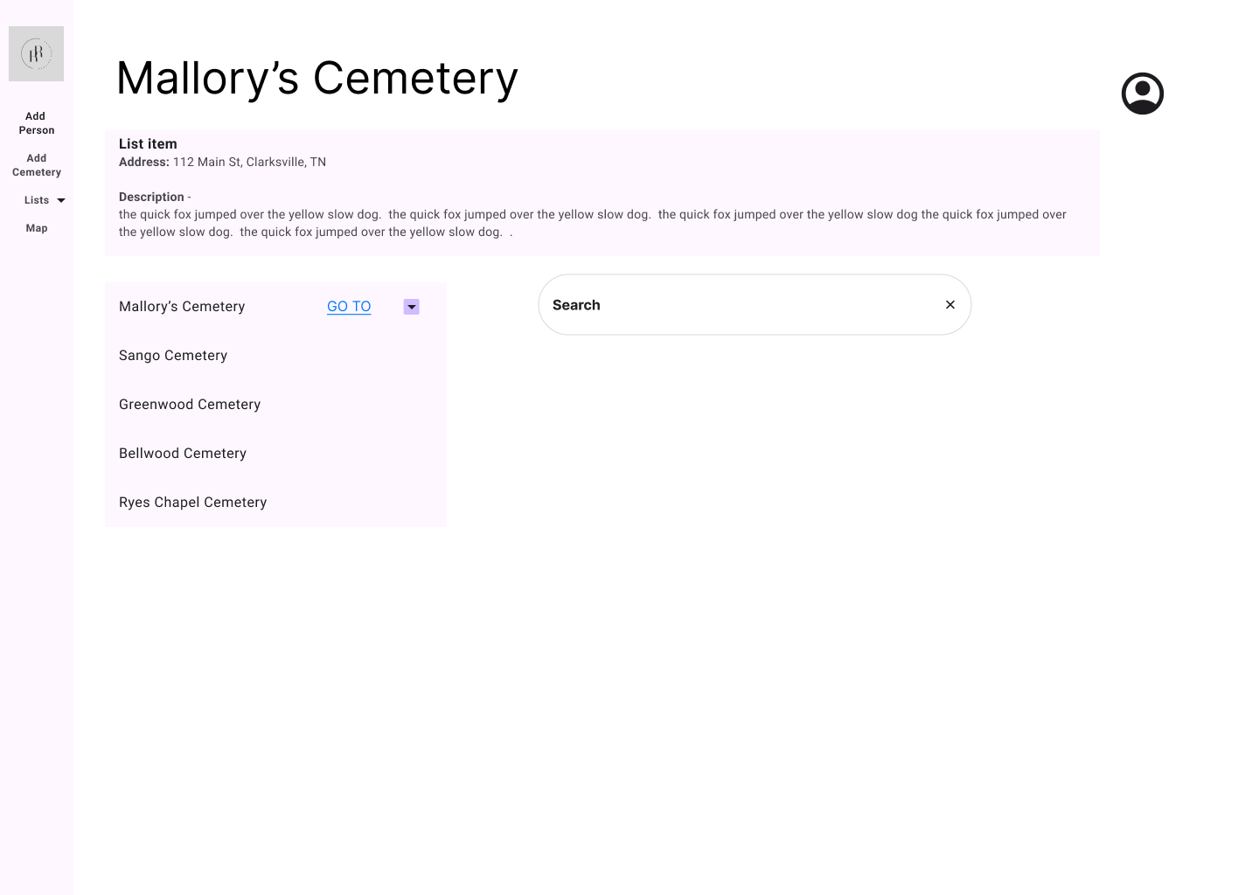
Design Overview
The project uses a modular React setup.
The src folder is divided into subdirectories to separate different parts of the website.
Each section handles a specific function, like cemetery data, maps, plots, and people.
A Figma mockup was made to agree on layout and features before starting development

Slide 5
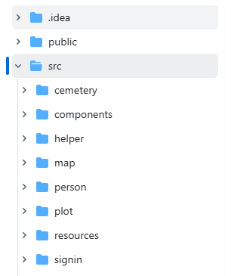
Design: src Directory and Core Files
Title: src/ Directory Structure
Key files:
App.jsx: Handles page routing and login checks.
index.js: Sets up the app and Google authentication.
HomePage.jsx: Public landing page with cemetery selection and person search.

Slide 6
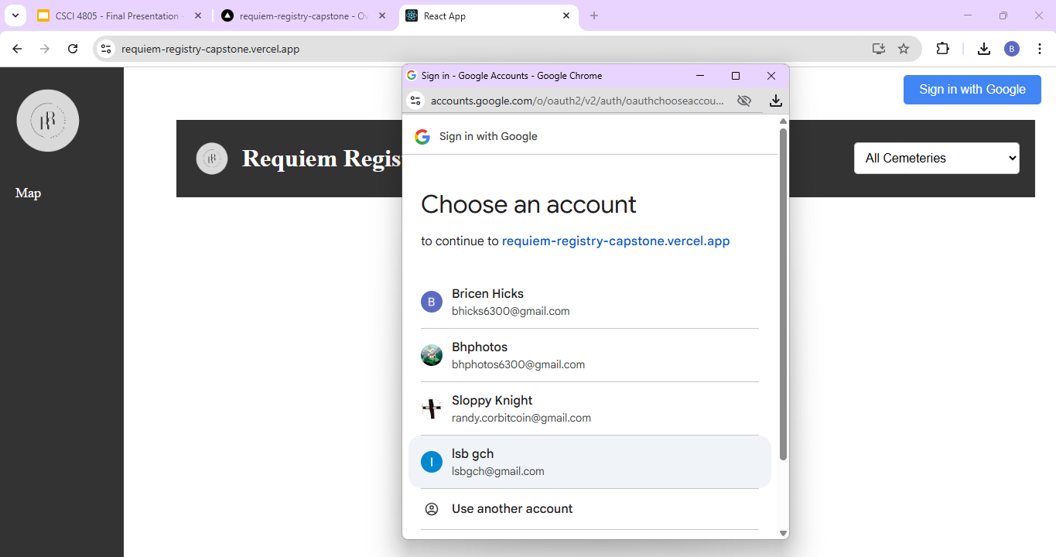
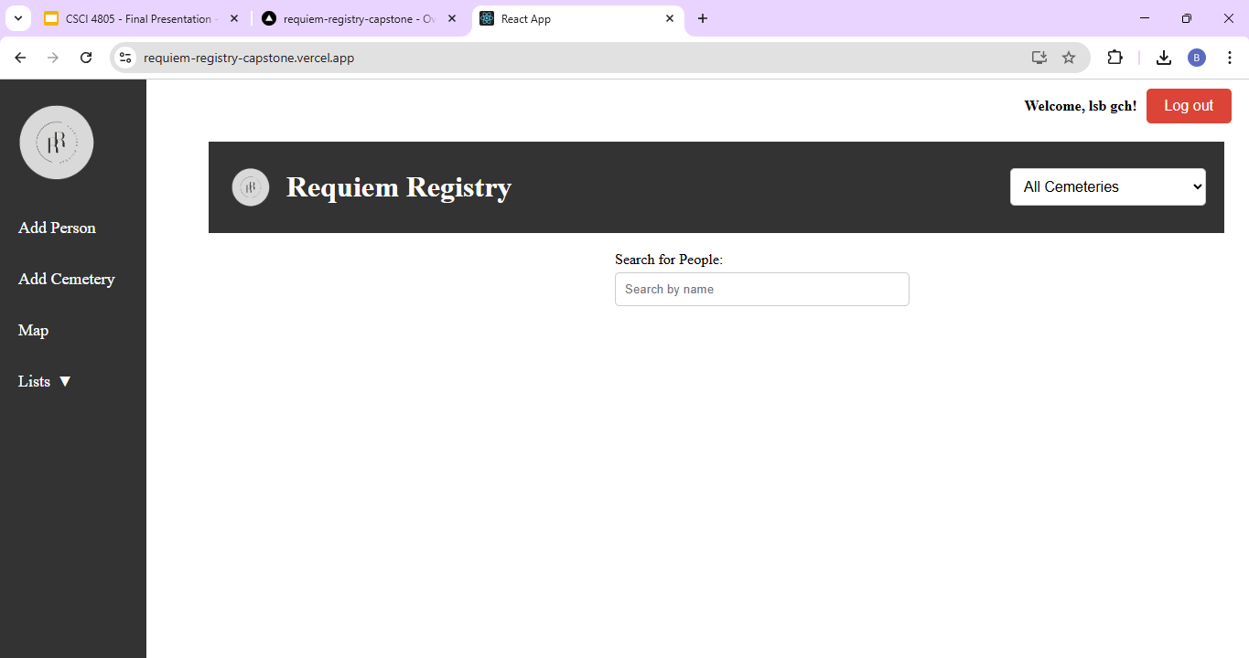
Design: Authentication and Routing Logic
App.jsx controls which pages users can access based on login status.
Logged-in users see different navigation options than general users.
Admins can add cemeteries, edit plots, and update person records.
The navigation bar and page routes change based on user type.

Slide 7
How to Deploy
Deployment is achieved via Github Repo being hosted and deployed on Vercel
To bypass Vercel collaborator restrictions we forked our Repo and then used that fork to deploy.
The project can be run locally for development and testing.
Changes are pushed to GitHub for version control and collaboration.
Final deployment is handled through Vercel for live access.
Shared GitHub and Vercel accounts are used for team-wide consistency.

Slide 8
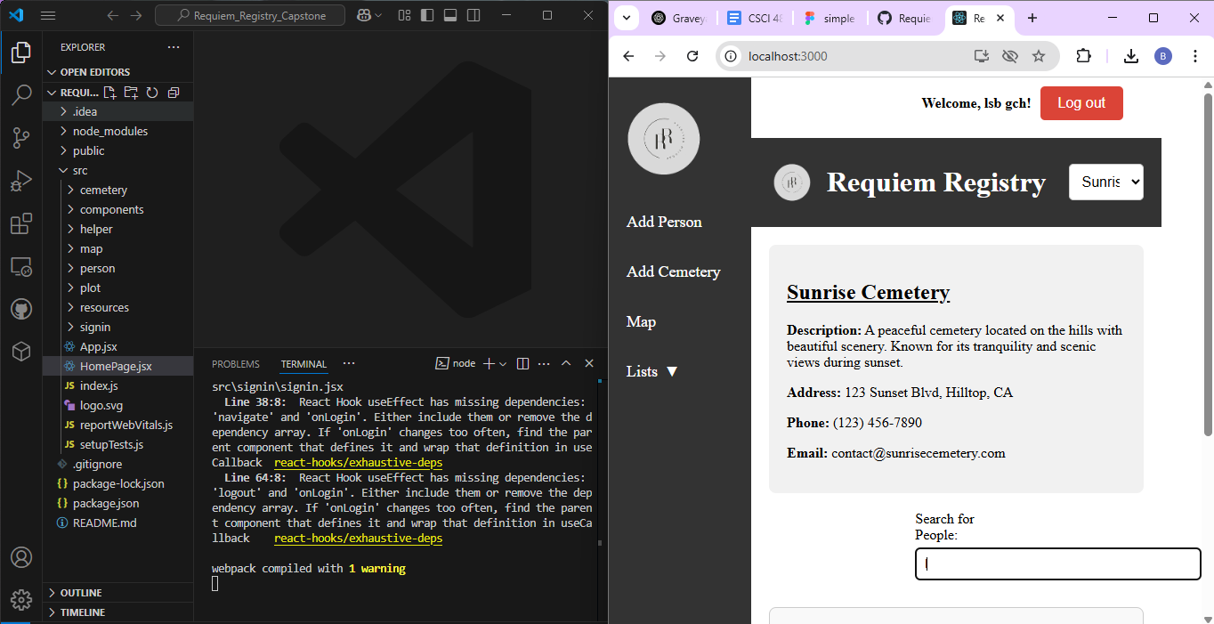
How to Deploy: Local Version
Clone the repository from GitHub into your IDE (VSCode, WebStorm, etc.).
Run the project locally to view and test changes
Use git pull, git add, git commit, and git push to manage updates.
Continue merging and updating code until the project is complete.
Notes:
Deploying the website locally begins with cloning the repository from its GitHub and accessing it with an Integrated Development Environment. Once in the IDE, whether it’s Webstorm or VSCode, the next step is to open the its terminal and enter the commands NPM Install and NPM Start; this will deploy a localhost for the website, which can be accessed by any browser on the machine.
Any changes to the source code can be made with the IDE and these updates can be managed with repository actions like push, pull, add, commit and merge until the site is in a satisfactory state.

Slide 9
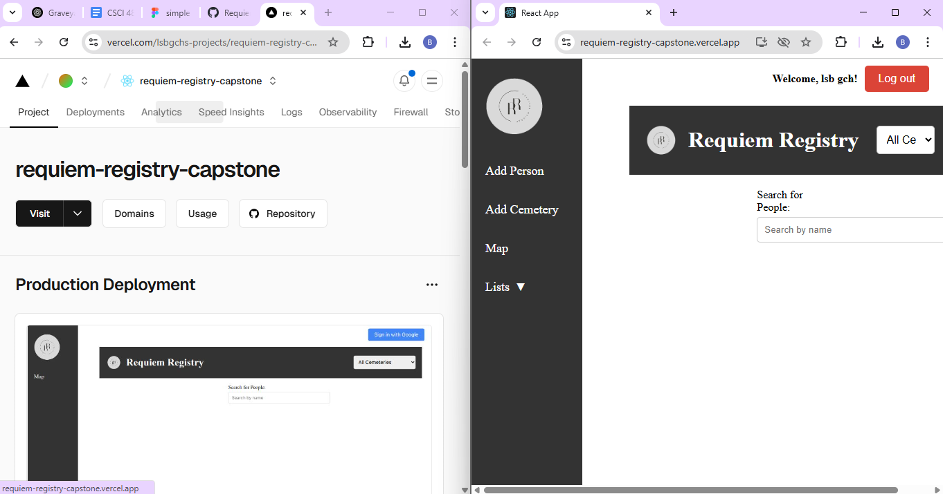
How to Deploy: Online Version
Use the shared Gmail to fork the project from the original GitHub.
Log in to Vercel using the same shared account.
Import the forked project from GitHub into Vercel.
Vercel will automatically deploy on each push to the connected branch
Notes:
When ready for online deployment, the website’s repository can be deployed via Vercel. However, this simple process is limited to those working on the repository alone or who can pay Vercel to allow additional people to work on the repository. For everyone else, it is recommend that a Gmail account be created and used to make a corresponding GitHub and Vercel account. With this, the original or cloned repository for Requiem Registry can be forked and deployed with Vercel. Any updates or future deployments would be handled by this master account, which would be shared among the development team to evade the Vercel’s collaboration fees.

Slide 10
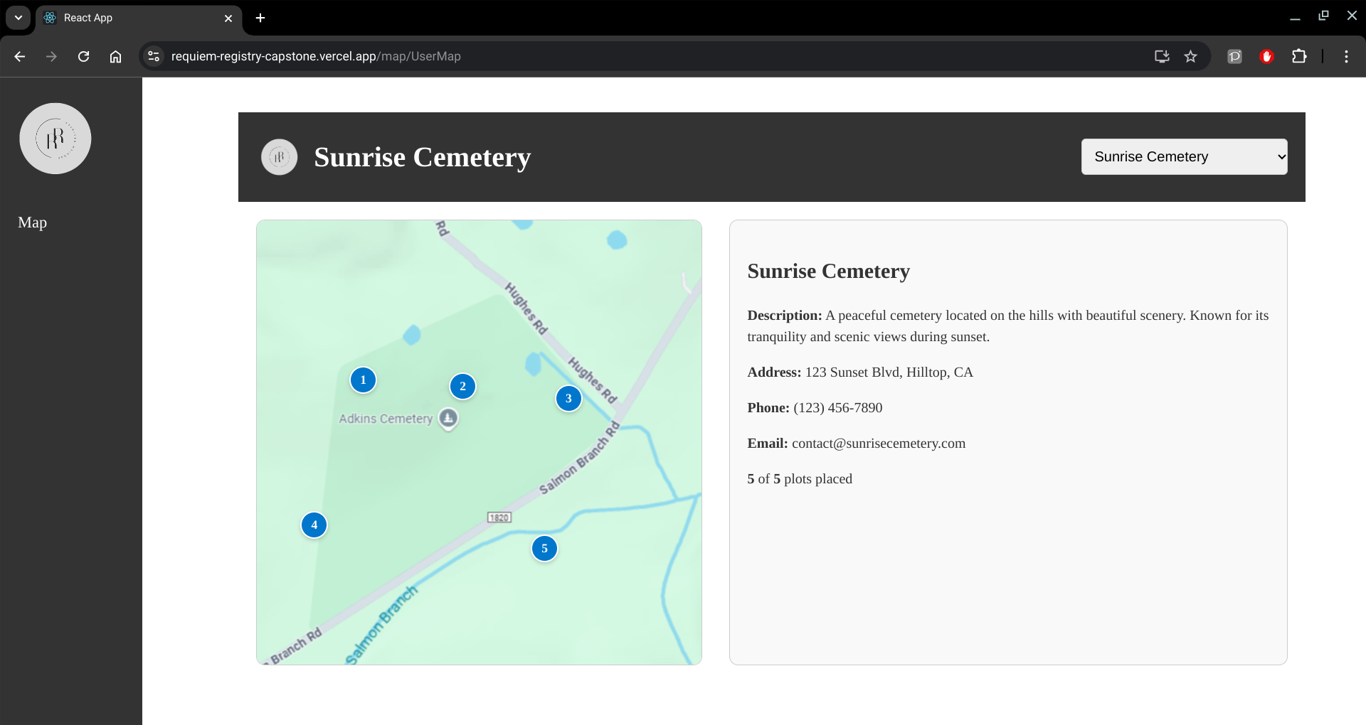
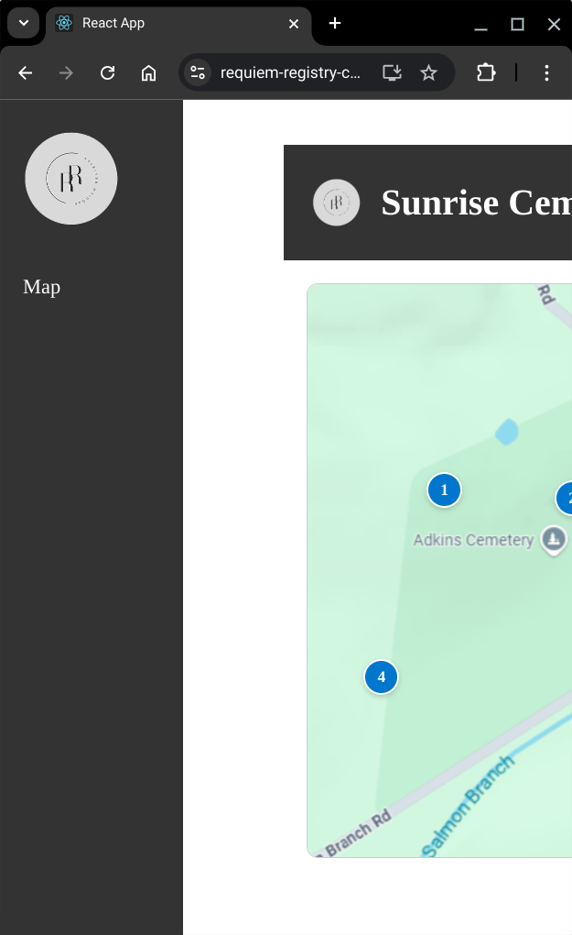
Known Issues
Next of Kin attributes vestigial
No way to enter Next of Kin info
Lacks responsive design
Looks bad on mobile
No Google Maps integration
Current maps are just PNGs
No Safe Deletion
Deleting database entries is permanent.
Only one administrator
Writing privileges over all cemeteries held by one account.
Notes:
Requiem Registry isn’t perfect; it has bugs and incomplete features, five of which are listed here. Starting at the top, there’s the Next of Kin attributes from the person’s table. These were supposed to hold info about a person’s closest relative, which caretakers would use to contact them if needed. Adding these to the table and website would be easy considering the attributes that have been created so far; the reason we haven’t is because this feature is more of an addition than a necessity, the latter being our priority. The same reason applies to the website’s responsive design, or lack thereof. It looks decent on desktop, but it’ll look weird and claustrophobic if you narrow the window too much or open the site on mobile. Solving this would require a better understanding of HTML and CSS, as well as possibly revising the mock ups for each page so that implementing a responsive design is easier. Looking at the examples on this slide, a lot of you may be wondering ‘is that Google Maps?’, it’s only a PNG. Integrating Google Maps into the site was one of the first features that was cut; studying it’s API while addressing any bugs that came up would take time we couldn’t spare. Instead, we decided early on that maps on the site would be a static image linked to their cemetery. Next, and a tad more severe, is the website’s delete operation; it is permanent. There is currently a popup that asks the admin to confirm before deleting anything, but this can be improved by adding a “isDeleted” boolean attribute to all tables. This’d be set to false initially, but once it’s set to true with the delete operation, the entry would be filtered out of all future queries. This would allow an easy path to restore the entry later if needed. Lastly, a big issue for Requiem Registry is it only has one admin; who has reading and writing privileges for all of the database’s entries. Solving this would need a system that can add and remove admins, limit their privileges by cemetery if needed, designate a person or persons to make these choices (aka administrate the administrators), all the while ensuring the system is secure but not so secure that it gets deadlocked if someone at the top croakes or forgets their password. As with all these issues, we simply didn’t have enough time.

Slide 11
Thank you!

